Slide 1
Covariance

Slide 2
Covariance
Covariance: Quantifies how changes in one variable relate to changes in another
Scale:
Covariance: Units of what we are measuring (difficult to interpret)
Correlation: -1 and +1 (easy)
Example:
As area increases, price increases: But by how much? … Covariance
Area of the House | Price of the House
1200 | 75 lakhs
1300 | 90 lakhs
1500 | 1.10 crores

Slide 3
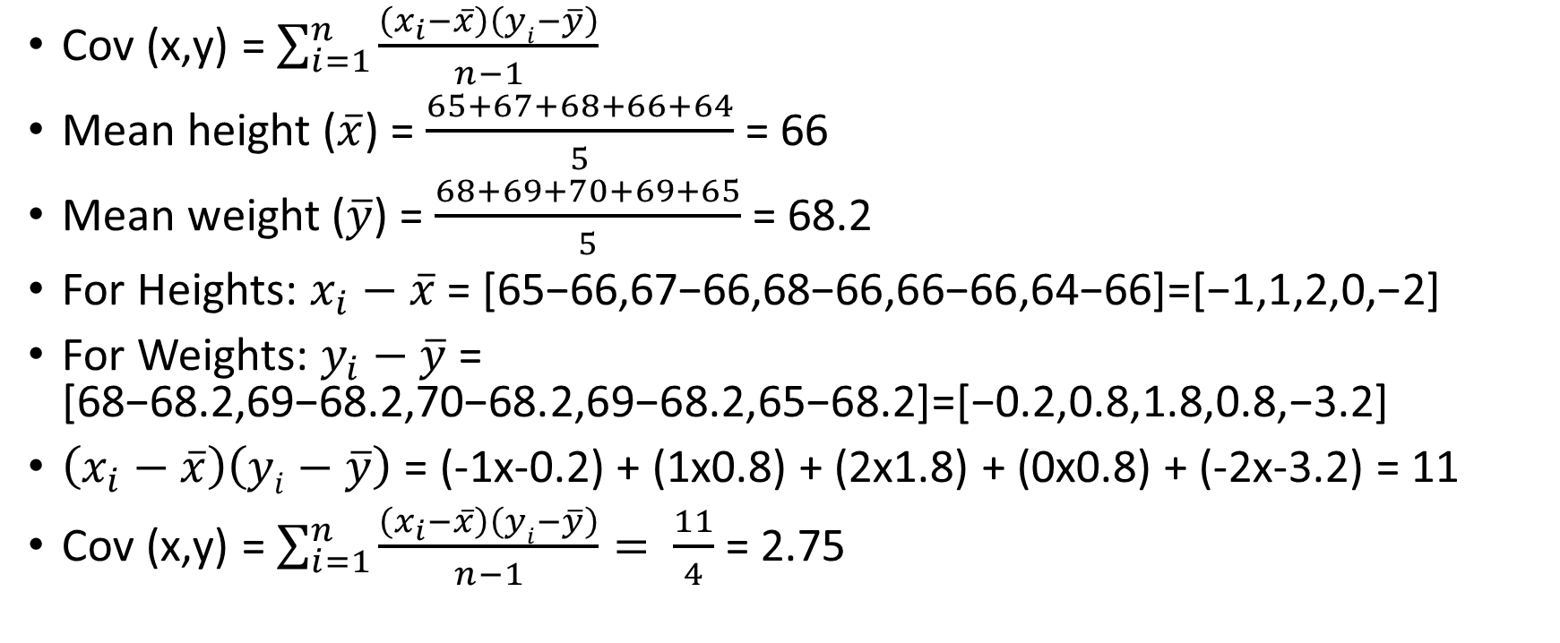
Covariance Example
Height | Weight
65 | 68
67 | 69
68 | 70
66 | 69
64 | 65
Cov (x,y) = $\sum_{i=1}^{n}{\frac{\left(x_{i}−\overline{x}\right)\left(yi−\overline{y}\right)}{n−1}}$
Mean height ($\overline{x}$) = $\frac{65+67+68+66+64}{5}$ = 66
Mean weight ($\overline{y}$) = $\frac{68+69+70+69+65}{5}$ = 68.2
For Heights: $x_{i}−\overline{x}$= [65−66,67−66,68−66,66−66,64−66]=[−1,1,2,0,−2]
For Weights: $y_{i}−\overline{y}$= [68−68.2,69−68.2,70−68.2,69−68.2,65−68.2]=[−0.2,0.8,1.8,0.8,−3.2]
$\left(x_{i}−\overline{x}\right)\left(yi−\overline{y}\right)$ = (-1x-0.2) + (1x0.8) + (2x1.8) + (0x0.8) + (-2x-3.2) = 11
Cov (x,y) = $\sum_{i=1}^{n}{\frac{\left(x_{i}−\overline{x}\right)\left(yi−\overline{y}\right)}{n−1}}= \frac{11}{4}$ = 2.75

Slide 4
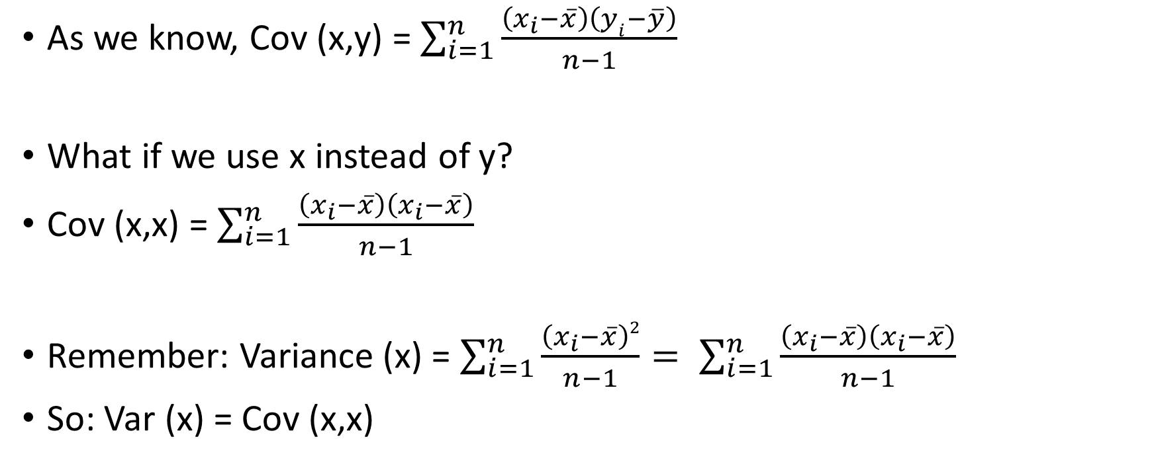
Covariance and Variance
As we know, Cov (x,y) = $\sum_{i=1}^{n}{\frac{\left(x_{i}−\overline{x}\right)\left(yi−\overline{y}\right)}{n−1}}$
What if we use x instead of y?
Cov (x,x) = $\sum_{i=1}^{n}{\frac{\left(x_{i}−\overline{x}\right)\left(x_{i}−\overline{x}\right)}{n−1}}$
Remember: Variance (x) = $\sum_{i=1}^{n}{\frac{\left(x_{i}−\overline{x}\right)2}{n−1}}= \sum_{i=1}^{n}{\frac{\left(x_{i}−\overline{x}\right)\left(x_{i}−\overline{x}\right)}{n−1}}$
So: Var (x) = Cov (x,x)

Slide 5
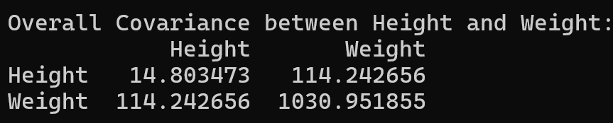
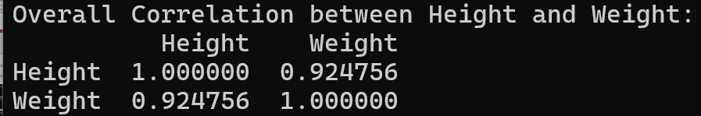
Covariance Example
C:\code\Data Analytics\correlation_covariance_height_weight.py
Diagonal elements: Variance of the variable (Height: 14, Weight: 1030)
Off-diagonal elements: Covariance between the two variables (114)
Since 114 > 0: As height increases/decreases, so does weight
Covariance = 114: No real interpretation on its own
But Correlation = 0.92: Very easy to interpret

Slide 6
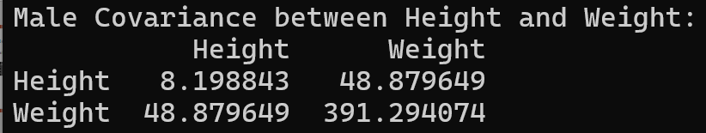
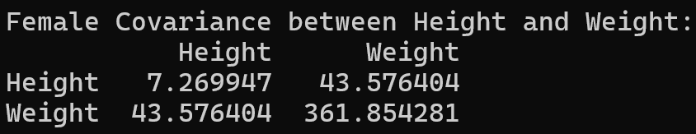
Covariance Interpretation
Compare covariance for three cases: (1) overall (2) males (3) females
Overall covariance = 114, For males = 48, For females = 43
Other statistics (Calculated separately):
male records: 5001, average height: 69, average weight: 187
female records: 5001, average height: 63, average weight: 135
Heights and weights are positively related in all three cases
Gender difference: Males are consistently taller and have more weight
So, although within group covariances are low, difference in means contributes to a higher overall covariance
That is, higher covariance pulls the lower covariance to a higher value (See next slide)

Slide 7
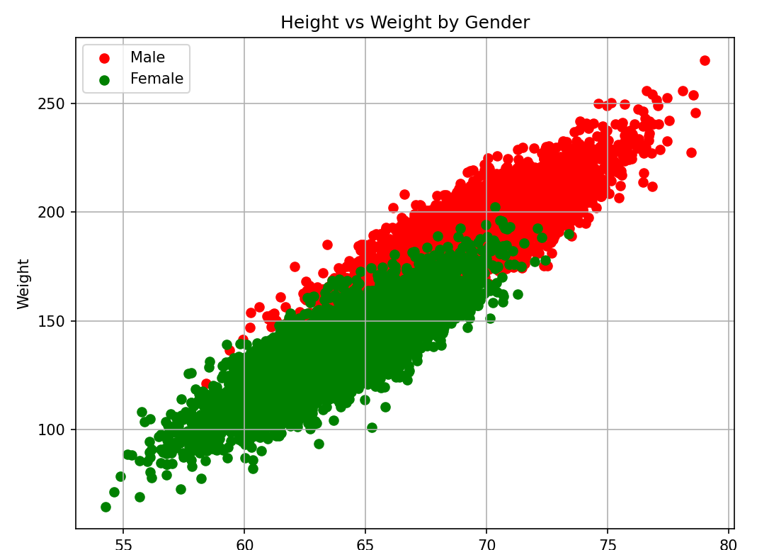
Covariance Interpretation
Plotting all data points: C:\code\Data Analytics\scatter_plot_heights_weights.py
Higher covariance in male records pulls lower covariance of females records to a higher side

Slide 8
Correlation

Slide 9
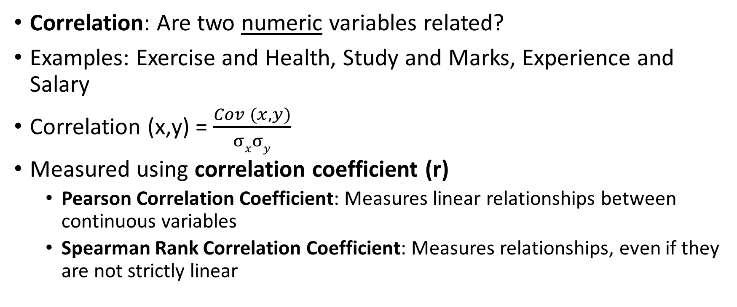
Correlation
Correlation: Are two numeric variables related?
Examples: Exercise and Health, Study and Marks, Experience and Salary
Correlation (x,y) = $\frac{Cov (x, y)}{σxσy}$
Measured using correlation coefficient (r)
Pearson Correlation Coefficient: Measures linear relationships between continuous variables
Spearman Rank Correlation Coefficient: Measures relationships, even if they are not strictly linear

Slide 10
Pearson Correlation Coefficient Interpretation
Range: -1 to +1
Positive correlation: Variables move up together
Example: Correlation of 0.80 between Hours spent studying and test scores
Negative correlation: As one variable moves up, the other moves down
Example: Correlation of -0.70 between Hours spent watching TV and physical fitness
Zero correlation: Variables are unrelated
Example: Correlation of 0.02 between Shoe size and IQ score

Slide 11
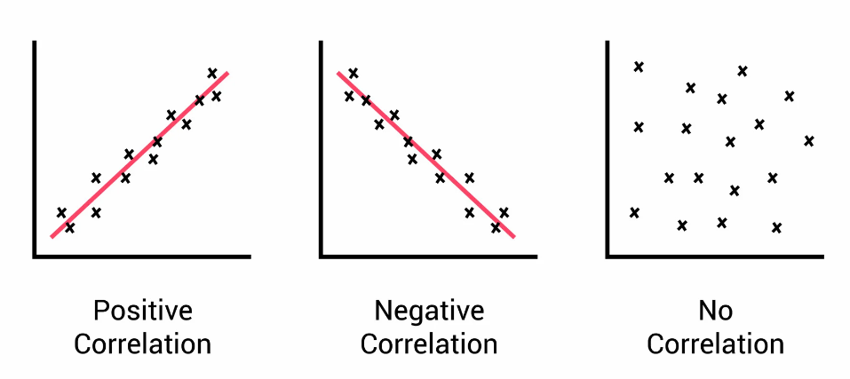
Positive, Negative, No Correlation

Slide 12

Pearson Correlation Coefficient for Earlier Example
Height | Weight
65 | 68
67 | 69
68 | 70
66 | 69
64 | 65
Corr(x,y) = $\frac{Cov (x, y)}{σxσy}$
Corr(x,y) = $\frac{2.75}{1.58 x 1.92}$
Corr(x,y) = $\frac{2.75}{1.58 x 1.92}$ = 0.90

Slide 13
Key Point about Correlation
Find correlation between related variables (e.g. hours of study and marks obtained, but not hours of study and time needed to reach C-DAC)
See C:\code\Data Analytics\correlation-outliers-bad-example.py
Better example: correlation_better_example.py
Good example: correlation-positive-currency-rates.py

Slide 14
Correlation Examples
C:\code\Data Analytics\correlation-2.py
C:\code\Data Analytics\correlation_poor.py
Assignment: Find the correlation between pace and official time columns of the combined marathon datasets (C:\code\Data Analytics\correlation_good_marathon.py)

Slide 15
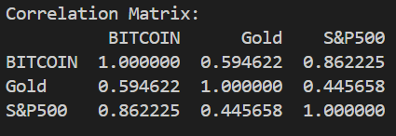
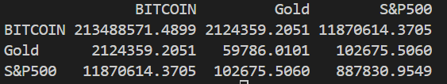
Covariance Example
C:\code\Data Analytics\correlation-covariance-crypto-gold.py
Interpretation: Correlation
Interpretation: Covariance

Slide 16
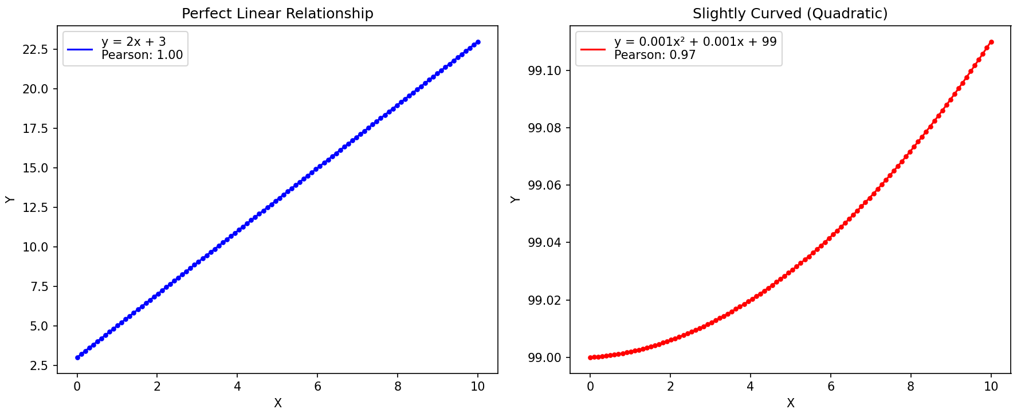
Why Spearman Rank Correlation?
Pearson correlation coefficient: Works well when data is linear, but not well when the data is not linear

Slide 17
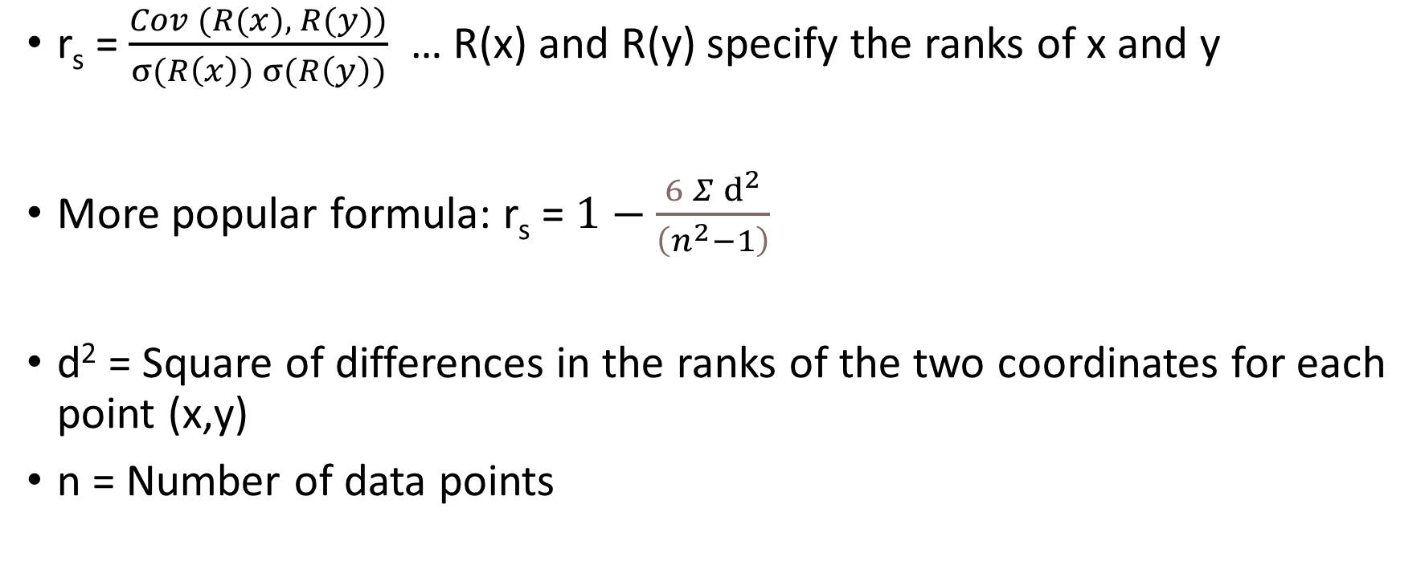
Spearman Rank Correlation
r_{s} = $\frac{Cov (R(x), R(y))}{σ(R\left(x\right)) σ(R\left(y\right))}$ … R(x) and R(y) specify the ranks of x and y
More popular formula: r_{s} = $1−\frac{6 Σⅆ^{2}}{\left(n^{2}−1\right)}$
d² = Square of differences in the ranks of the two coordinates for each point (x,y)
n = Number of data points

Slide 18
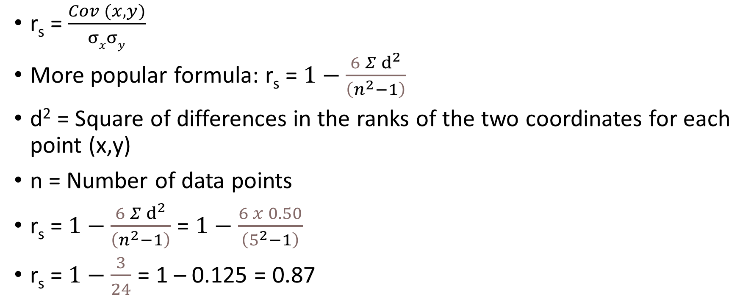
Spearman Rank Correlation Coefficient for Earlier Example
Height | Weight
65 | 68
67 | 69
68 | 70
66 | 69
64 | 65
r_{s} = $\frac{Cov (x, y)}{σxσy}$
More popular formula: r_{s} = $1−\frac{6 Σⅆ^{2}}{\left(n^{2}−1\right)}$
d² = Square of differences in the ranks of the two coordinates for each point (x,y)
n = Number of data points
r_{s} = $1−\frac{6 Σⅆ^{2}}{\left(n^{2}−1\right)}$ = $1−\frac{6 x 0.50}{\left(5^{2}−1\right)}$
r_{s} = $1−\frac{3}{24}$ = 1 – 0.125 = 0.87
x_{i} | R_{x} | y_{i} | R_{y} | d_{i} = R_{x} - R_{y} | d_{i}²
65 | 2 | 68 | 2 | 0 | 0
67 | 4 | 69 | 3.5 | 0.5 | 0.25
68 | 5 | 70 | 5 | 0 | 0
66 | 3 | 69 | 3.5 | -0.5 | 0.25
64 | 1 | 65 | 1 | 0 | 0

Slide 19
Population and Sample, Probability Theory

Slide 20
Population and Sample
Sampling
Population
Sample
Sample statistic (x̄)
Estimate
Population parameter (μ)
10000 students in a university
Question: What is the average student height?
Difficult: Measure the actual height of the population, i.e. all 10000 students to calculate the average (parameter)
Easier: Take a sample of 500 students, calculate the average and use it to estimate the population average (statistic)
Population Parameter | Symbol | Sample Statistic | Symbol
Mean | μ (Mu) | Sample Mean | x̄ (x bar)
Standard Deviation | σ (Sigma) | Sample Standard Deviation | s
Proportion | π (Pi) | Sample Proportion | p̂ (p-hat)

Slide 21
Sampling Types
Univariate Sampling | Bivariate Sampling
Analysis of a single variable | Analysis of two variables to find relationship between them
Analyzing the ages of individuals in a population Examining the heights of a sample of students Studying the test scores of students in a class | Amount of time spent studying (variable 1) and the Test scores achieved (variable 2) Education (variable 1) and the Income level (variable 2)
Descriptive statistics such as mean, mode, median, variance, standard deviation | Correlation, Regression
Histogram, Box plot | Scatter plot, Heatmap

Slide 22
Resampling
Resampling: Modifying a dataset by changing its size or composition
How? Bootstrapping or Cross-validation
Bootstrapping: Generating multiple new samples (called bootstrap samples) from the original dataset by randomly selecting data points with replacement – Useful in estimating population parameters, regression analysis
Cross-validation: Dividing the dataset into a training set and a testing set, and iteratively training and evaluating the model on different combinations of these subsets – Useful in machine learning model evaluation (See next slide)

